Slide 1
Group Presentations
Group 13: Jeremy, Qistina, Abdurrahim, Masud

Slide 2
Group Presentations
Group 13: Jeremy, Qistina, Abdurrahim, Masud

Slide 3
Table of contents
01
02
03
04
Introduction
Classification of E-Customer
Sessions
Brief Overview of SVMs
Kernels functions
Gene Expression Data Classification
Conclusion
Problem
Solution
Experiment and Results
Reflections

Slide 4
Table of contents
01
02
03
04
Brief Overview of SVMs
Kernels functions
Introduction
Problem
Solution
Experiment and Results
Reflections
Classification of E-Customer
Sessions
Gene Expression Data Classification
Conclusion
Justification
Comparison

Slide 5
Table of contents
01
02
03
04
Problem
Solution
Experiment and Results
Reflections
Introduction
Classification of E-Customer
Sessions
Justification
Comparison
Gene Expression Data Classification
Conclusion

Slide 6
01
Introduction

Slide 7
Support Vector Machines Explained
To explain simple classification. Imagine we have a number line
Not Obese
Obese
Mass(kg)
Margin

Slide 8
Support Vector Machines Explained
To explain simple classification. Imagine we have a number line
Not Obese
Obese
Mass(kg)
Margin

Slide 9
Support Vector Machines Explained
To explain simple classification. Imagine we have a number line
Not Obese
Obese
Mass(kg)
Margin

Slide 10
Support Vector Machines Explained
To explain simple classification. Imagine we have a number line
Not Obese
Obese
Mass(kg)
Margin

Slide 11
Here our number line has a few misclassifications
Margins that allow misclassifications are known as Soft Margin Classifier AKA Support Vector classifier

Slide 12
Let us take a look at another example in this case we are looking at drug dosages
Right amount of dosage
Too much dosage
Too little dosage
Dosages(Mg)

Slide 13
Let us take a look at another example in this case we are looking at drug dosages
Wherever we put our classifier we would make a lot of misclassifications
Dosages(Mg)

Slide 14
Let us take a look at another example in this case we are looking at drug dosages
Wherever we put our classifier we would make a lot of misclassifications
Dosages(Mg)

Slide 15
Let us take a look at another example in this case we are looking at drug dosages
Wherever we put our classifier we would make a lot of misclassifications
Dosages(Mg)

Slide 16
Since we would make a lot of misclassifications this is where the idea of Support Vector Machines come in
Dosages(Mg)

Slide 17
Let us introduce a Y-Axis
Y-Axis
Dosages(Mg)

Slide 18
The Y-axis co-ordinates would be (Dosages²)
Y-Axis
Dosages(Mg)

Slide 19
Y-Axis
Let us look at this observation with Dosage = 0.5
Dosages(Mg)

Slide 20
Y-Axis
The y-axis value = Dosage²
= 0.5²
= 0.25
0.25
Dosages(Mg)

Slide 21
Let us plot for the rest of the
observations
Y-Axis
0.25
Dosages(Mg)

Slide 22
And now the data is 2-Dimensional we can now draw a support vector classifier that separates the right dosages from the wrong dosages
Y-Axis
Dosages(Mg)

Slide 23
We can now use it to classify new observations
Y-Axis
Dosages(Mg)

Slide 24
For example if a new observation had this dosage
Y-Axis
Dosages(Mg)

Slide 25
We can calculate the y-axis coordinate by squaring the dosage
Y-Axis
Dosages(Mg)

Slide 26
Classifying this observation as a wrong dosage
Y-Axis
Dosages(Mg)

Slide 27
On the other hand if we got a new observation with this dosage
Y-Axis
Dosages(Mg)

Slide 28
We would classify this observation as a good dosage
Y-Axis
As it falls of the other side
of the support vector classifier
Dosages(Mg)

Slide 29
The main ideas behind Support Vector Machines
are..
Y-Axis
Dosages(Mg)

Slide 30
1) Start with data in a relatively low dimension
Y-Axis
Dosages(Mg)

Slide 31
2) Move the data into a higher dimension
Y-Axis
In this example we moved from 1-dimension to 2 dimensions
Dosages(Mg)

Slide 32
3) Find a Support Vector Classifier that separates the higher dimensional data into two groups
Y-Axis
Dosages(Mg)

Slide 33
You might be wondering...
How do we decide how to transform the data?

Slide 34
You might be wondering...
How do we decide how to transform the data?
This is where Kernels come into play. Support Vector Machines use kernel functions to systematically find Support Vector classifiers in higher dimensions.

Slide 35
Kernel Functions
There are 4 different Kernel Functions in each paper
Quadratic
Sigmoid
Polynomial
Linear
Radial
In Study 2
In Study 1
In Study 1 & 2
In Study 1 & 2
In Study 1 & 2
Later in the presentation, we’ll delve into the equations and algorithms in detail.

Slide 36
02
Classification of E-Customer Sessions Based on Support Vector Machines

Slide 37
02
Classification of E-Customer Sessions Based on Support Vector Machines

Slide 38
Problem
Objective
Data Imbalance
Predict buying behaviour by distinguishing potential buyers from casual browsers.
Imbalance between browsing and buying sessions complicates accurate classification.
Conversion Need
High-traffic e-commerce sites struggle to convert visitors into buyers, creating demand for predictive models.
Notes:
provide predictive and personalized experiences to convert visitors into buyers. Despite high traffic, only a small fraction of visits lead to actual purchases, creating a need for targeted prediction to increase conversion rates.
distinguishing between potential buyers and casual browsers, allowing e-commerce platforms to optimize customer engagement strategies and prioritize likely buyers.

Slide 39
Problem
Objective
Conversion Need
Data Imbalance
Predict buying behaviour by distinguishing potential buyers from casual browsers.
High-traffic e-commerce sites struggle to convert visitors into buyers, creating demand for predictive models.
Imbalance between browsing and buying sessions complicates accurate classification.
Notes:
provide predictive and personalized experiences to convert visitors into buyers. Despite high traffic, only a small fraction of visits lead to actual purchases, creating a need for targeted prediction to increase conversion rates.
distinguishing between potential buyers and casual browsers, allowing e-commerce platforms to optimize customer engagement strategies and prioritize likely buyers.

Slide 40
Solution
SVM was chosen to classify user sessions, using four kernels (linear, polynomial, radial, and sigmoid). Each SVM model was tuned for maximum accuracy.
Sessions were reconstructed from low-level HTTP data, allowing the model to generalize without high-level data dependency.
Data imbalance between browsing and buying sessions was addressed by resampling or adjusting class weights for balanced classification.

Slide 41
Solution
SVM was chosen to classify user sessions, using four kernels (linear, polynomial, radial, and sigmoid). Each SVM model was tuned for maximum accuracy.
Sessions were reconstructed from low-level HTTP data, allowing the model to generalize without high-level data dependency.
Data imbalance between browsing and buying sessions was addressed by resampling or adjusting class weights for balanced classification.

Slide 42
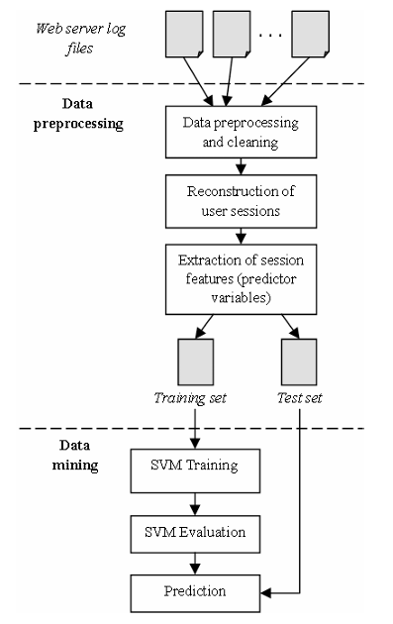
Data Classification and Modelling Process
Data Preprocessing: Clean web server logs and reconstruct user sessions.
Feature Extraction: Identify session features (e.g., pages visited, session duration).
Data Split: Divide data into training and test sets.
Prediction: Use the model to predict future sessions' likelihood of purchase.
SVM Training and Evaluation: Train SVM on the training set and evaluate accuracy on the test set to classify sessions as buying or browsing.

Slide 43
Data Classification and Modelling Process
Data Preprocessing: Clean web server logs and reconstruct user sessions.
Feature Extraction: Identify session features (e.g., pages visited, session duration).
Data Split: Divide data into training and test sets.
Prediction: Use the model to predict future sessions' likelihood of purchase.
SVM Training and Evaluation: Train SVM on the training set and evaluate accuracy on the test set to classify sessions as buying or browsing.

Slide 44
Data Classification and Modelling Process
Data Preprocessing: Clean web server logs and reconstruct user sessions.
Feature Extraction: Identify session features (e.g., pages visited, session duration).
Data Split: Divide data into training and test sets.
SVM Training and Evaluation: Train SVM on the training set and evaluate accuracy on the test set to classify sessions as buying or browsing.
Prediction: Use the model to predict future sessions' likelihood of purchase.

Slide 45
Data Classification and Modelling Process
Data Preprocessing: Clean web server logs and reconstruct user sessions.
Feature Extraction: Identify session features (e.g., pages visited, session duration).
Data Split: Divide data into training and test sets.
SVM Training and Evaluation: Train SVM on the training set and evaluate accuracy on the test set to classify sessions as buying or browsing.
Prediction: Use the model to predict future sessions' likelihood of purchase.

Slide 46
Data Classification and Modelling Process
Data Preprocessing: Clean web server logs and reconstruct user sessions.
Feature Extraction: Identify session features (e.g., pages visited, session duration).
Data Split: Divide data into training and test sets.
SVM Training and Evaluation: Train SVM on the training set and evaluate accuracy on the test set to classify sessions as buying or browsing.
Prediction: Use the model to predict future sessions' likelihood of purchase.

Slide 47
Data Classification and Modelling Process
Data Preprocessing: Clean web server logs and reconstruct user sessions.
Feature Extraction: Identify session features (e.g., pages visited, session duration).
Data Split: Divide data into training and test sets.
SVM Training and Evaluation: Train SVM on the training set and evaluate accuracy on the test set to classify sessions as buying or browsing.
Prediction: Use the model to predict future sessions' likelihood of purchase.

Slide 48
Data Classification and Modelling Process
Data Preprocessing: Clean web server logs and reconstruct user sessions.
Feature Extraction: Identify session features (e.g., pages visited, session duration).
Data Split: Divide data into training and test sets.
SVM Training and Evaluation: Train SVM on the training set and evaluate accuracy on the test set to classify sessions as buying or browsing.
Prediction: Use the model to predict future sessions' likelihood of purchase.

Slide 49
Reconstruction of User Sessions
To predict online purchases, user sessions were classified into two categories based on whether the "checkout success" variable had a value of 1 or 0
Browsing Sessions (-)
Buying Sessions (+)
Refers to user interactions where no purchase is made
Refers to users who complete a purchase

Slide 50
Reconstruction of User Sessions
To predict online purchases, user sessions were classified into two categories based on whether the "checkout success" variable had a value of 1 or 0
Browsing Sessions (-)
Buying Sessions (+)
Refers to user interactions where no purchase is made
Refers to users who complete a purchase

Slide 51
Reconstruction of User Sessions
To predict online purchases, user sessions were classified into two categories based on whether the "checkout success" variable had a value of 1 or 0
Browsing Sessions (-)
Buying Sessions (+)
Refers to user interactions where no purchase is made
Refers to users who complete a purchase

Slide 52
To predict online purchases, user sessions were classified into two categories based on whether the "checkout success" variable had a value of 1 or 0
Browsing Sessions (-)
Buying Sessions (+)
Refers to user interactions where no purchase is made
Refers to users who complete a purchase

Slide 53
Classification Variables
23 session-based features were derived from HTTP log data, capturing user behavior metrics
Checkout Success
Checkout Try
Home
Register Success
Register Try
Login Success
Log off
Search
Browse
Is admin
Details
Add
Shipping Checkout
Shipping
Information
Entertainment
Pages Number
Request Number
Transfer
Duration
Page per time
Source
Is bot

Slide 54
Classification Variables
23 session-based features were derived from HTTP log data, capturing user behavior metrics
7 variables are related to user actions that reveal intent and engagement levels
3 of which highly predictive of buyers' behavior
Checkout Success
Checkout Try
Home
Register Success
Register Try
Login Success
Log off
Search
Browse
Is admin
Details
Add
Shipping Checkout
Shipping
Information
Entertainment
Pages Number
Request Number
Transfer
Duration
Page per time
Source
Is bot

Slide 55
Classification Variables
7 variables are related to user actions that reveal intent and engagement levels
3 of which highly predictive of buyers' behavior
Checkout Success
Checkout Try
Home
Register Success
Register Try
Login Success
Log off
Search
Browse
Is admin
Details
Add
Shipping Checkout
Shipping
Information
Entertainment
Pages Number
Request Number
Transfer
Duration
Page per time
Source
Is bot
Checkout
Success
(Target Variable)
Add to Cart
(Predictor Variable)
Product Detail Views
(Predictor Variable)
Primary label for classification
Directly represents a completed purchase
Reflects a user's transition from browsing to a potential purchase
Indicates a greater interest in making a purchase
Represents thorough consideration rather than a casual browser
Session Duration
Search Interactions
Home Page Visits
Total Pages Visited

Slide 56
Classification Variables
7 variables are related to user actions that reveal intent and engagement levels
3 of which highly predictive of buyers' behavior
Checkout
Success
(Target Variable)
Add to Cart
(Predictor Variable)
Product Detail Views
(Predictor Variable)
Primary label for classification
Directly represents a completed purchase
Reflects a user's transition from browsing to a potential purchase
Indicates a greater interest in making a purchase
Represents thorough consideration rather than a casual browser
Session Duration
Search Interactions
Home Page Visits
Total Pages Visited

Slide 57




Model Tuning
Four kernel functions were applied in this SVM classification models:
Linear
Polynomial
Radial
Sigmoid

Slide 58
Model Tuning
Four kernel functions were applied in this SVM classification models:
Linear
Polynomial
Radial
Sigmoid

Slide 59
Model Tuning
Four kernel functions were applied in this SVM classification models:
Linear
Polynomial
Radial
Sigmoid

Slide 60
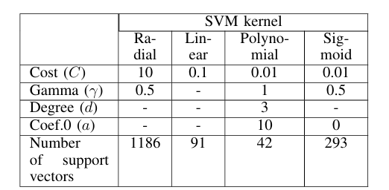
Model Tuning
The optimal parameter values determined for each kernel function for the same training set are presented in the table below. The SVM type was C-classification in all cases
Four kernel functions were applied in this SVM classification models:
Linear
Polynomial
Radial
Sigmoid

Slide 61
Model Tuning
The optimal parameter values determined for each kernel function for the same training set are presented in the table below. The SVM type was C-classification in all cases
Four kernel functions were applied in this SVM classification models:
Linear
Polynomial
Radial
Sigmoid

Slide 62
Experiment and Results

Slide 63
Experiment and Results
39,000
observations
The dataset had 39,000 user sessions, split into 26,000 for training (with 146 purchases) and 13,000 for testing (with 72 purchases), to assess the model's ability to predict purchases.

Slide 64
Experiment and Results
39,000
observations
The dataset had 39,000 user sessions, split into 26,000 for training (with 146 purchases) and 13,000 for testing (with 72 purchases), to assess the model's ability to predict purchases.
False Positives (FP): The number of browsing sessions incorrectly classified as buying sessions.
True Negatives (TN): The number of browsing sessions correctly classified as browsing sessions.
False Negatives (FN): The number of buying sessions incorrectly classified as browsing sessions.
.
Since the goal is to predict whether a session will result in a purchase (checkout success interaction), a buying session is considered a positive classification, while a browsing session is considered a negative classification.

Slide 65
Evaluation Metrics
Accuracy, error rate, and sensitivity were used as primary metrics to compare model performance across different kernels.

Slide 66
Evaluation Metrics
Accuracy, error rate, and sensitivity were used as primary metrics to compare model performance across different kernels.

Slide 67
Kernel Comparison
SVM Kernel Function | Browsing Sessions (Classified as Browsing) | Browsing Sessions (Classified as Buying) | Buying Sessions (Classified as Browsing) | Buying Sessions (Classified as Buying)
Radial | 12,928 | 0 | 58 | 14
Linear | 12,924 | 4 | 4 | 68
Polynomial | 12,923 | 5 | 12 | 60
Sigmoid | 12,928 | 72 | 0 | 0
Four SVM kernels (linear, polynomial, radial, sigmoid) were evaluated to determine which was best for classifying buying vs. browsing sessions.

Slide 68
Model Evaluation
The performance of the models varies based on the kernel function used. Here’s a summary of how each kernel performed
Comparison of Kernel Models
Linear Kernel
Polynomial Kernel
Radial and Sigmoid Kernels
Linear Kernel: This model performed the best, correctly classifying 68 buying sessions and misclassifying only 4. It had the highest accuracy in predicting buyers.
Polynomial Kernel: This model was also effective, correctly classifying 60 buying sessions, though not as effective as the linear kernel.
Radial and Sigmoid Kernels: Both of these kernel models were ineffective at predicting buying sessions, as evidenced by very poor performance in classifying buying sessions (few to no true positives).

Slide 69
Model Evaluation
The performance of the models varies based on the kernel function used. Here’s a summary of how each kernel performed
Comparison of Kernel Models
Linear Kernel
Polynomial Kernel
Radial and Sigmoid Kernels
Linear Kernel: This model performed the best, correctly classifying 68 buying sessions and misclassifying only 4. It had the highest accuracy in predicting buyers.
Polynomial Kernel: This model was also effective, correctly classifying 60 buying sessions, though not as effective as the linear kernel.
Radial and Sigmoid Kernels: Both of these kernel models were ineffective at predicting buying sessions, as evidenced by very poor performance in classifying buying sessions (few to no true positives).

Slide 70
Model Evaluation
The performance of the models varies based on the kernel function used. Here’s a summary of how each kernel performed
Comparison of Kernel Models
Linear Kernel
Polynomial Kernel
Radial and Sigmoid Kernels
Linear Kernel: This model performed the best, correctly classifying 68 buying sessions and misclassifying only 4. It had the highest accuracy in predicting buyers.
Polynomial Kernel: This model was also effective, correctly classifying 60 buying sessions, though not as effective as the linear kernel.
Radial and Sigmoid Kernels: Both of these kernel models were ineffective at predicting buying sessions, as evidenced by very poor performance in classifying buying sessions (few to no true positives).

Slide 71
Model Evaluation
The performance of the models varies based on the kernel function used. Here’s a summary of how each kernel performed
Comparison of Kernel Models
Linear Kernel
Polynomial Kernel
Radial and Sigmoid Kernels
Linear Kernel: This model performed the best, correctly classifying 68 buying sessions and misclassifying only 4.
Polynomial Kernel: This model was also effective, correctly classifying 60 buying sessions, though not as effective as the linear kernel.
Radial and Sigmoid Kernels: Both of these kernel models were ineffective at predicting buying sessions, as evidenced by very poor performance in classifying buying sessions.

Slide 72
Model Evaluation
To evaluate the performance of the four SVM classification models, we used the following measures based on the classification outcomes:
True Positives (TP): The number of buying sessions correctly classified as buying sessions.
False Positives (FP): The number of browsing sessions incorrectly classified as buying sessions.
True Negatives (TN): The number of browsing sessions correctly classified as browsing sessions.
False Negatives (FN): The number of buying sessions incorrectly classified as browsing sessions.
.
Since the goal is to predict whether a session will result in a purchase (checkout success interaction), a buying session is considered a positive classification, while a browsing session is considered a negative classification.

Slide 73
Model Evaluation
To evaluate the performance of the four SVM classification models, we used the following measures based on the classification outcomes:
True Positives (TP): The number of buying sessions correctly classified as buying sessions.
False Positives (FP): The number of browsing sessions incorrectly classified as buying sessions.
True Negatives (TN): The number of browsing sessions correctly classified as browsing sessions.
False Negatives (FN): The number of buying sessions incorrectly classified as browsing sessions.
.
Since the goal is to predict whether a session will result in a purchase (checkout success interaction), a buying session is considered a positive classification, while a browsing session is considered a negative classification.

Slide 74
Model Evaluation
To evaluate the performance of the four SVM classification models, we used the following measures based on the classification outcomes:
True Positives (TP): The number of buying sessions correctly classified as buying sessions.
False Positives (FP): The number of browsing sessions incorrectly classified as buying sessions.
True Negatives (TN): The number of browsing sessions correctly classified as browsing sessions.
False Negatives (FN): The number of buying sessions incorrectly classified as browsing sessions.
Since the goal is to predict whether a session will result in a purchase (checkout success interaction), a buying session is considered a positive classification, while a browsing session is considered a negative classification.

Slide 75
Model Evaluation
To evaluate the performance of the four SVM classification models, we used the following measures based on the classification outcomes:
True Positives (TP): The number of buying sessions correctly classified as buying sessions.
False Positives (FP): The number of browsing sessions incorrectly classified as buying sessions.
True Negatives (TN): The number of browsing sessions correctly classified as browsing sessions.
False Negatives (FN): The number of buying sessions incorrectly classified as browsing sessions.
Since the goal is to predict whether a session will result in a purchase (checkout success interaction), a buying session is considered a positive classification, while a browsing session is considered a negative classification.

Slide 76



Evaluation Metrics
Model Evaluation
To evaluate the performance of the four SVM classification models, we used the following measures based on the classification outcomes:
True Positives (TP): The number of buying sessions correctly classified as buying sessions.
False Positives (FP): The number of browsing sessions incorrectly classified as buying sessions.
01. Error rate
02. Accuracy
03. Sensitivity
This is calculated as the sum of false positives and false negatives divided by the total number of classifications
This measures the overall rate of correct classifications
particularly valuable in e-commerce, provides an estimate of the probability of predicting a buying session
True Negatives (TN): The number of browsing sessions correctly classified as browsing sessions.
False Negatives (FN): The number of buying sessions incorrectly classified as browsing sessions.
Since the goal is to predict whether a session will result in a purchase (checkout success interaction), a buying session is considered a positive classification, while a browsing session is considered a negative classification.

Slide 77
Evaluation Metrics
Model Evaluation
To evaluate the performance of the four SVM classification models, we used the following measures based on the classification outcomes:
True Positives (TP): The number of buying sessions correctly classified as buying sessions.
False Positives (FP): The number of browsing sessions incorrectly classified as buying sessions.
01. Error rate
02. Accuracy
03. Sensitivity
This is calculated as the sum of false positives and false negatives divided by the total number of classifications
This measures the overall rate of correct classifications
Particularly valuable in e-commerce, provides an estimate of the probability of predicting a buying session
True Negatives (TN): The number of browsing sessions correctly classified as browsing sessions.
False Negatives (FN): The number of buying sessions incorrectly classified as browsing sessions.
Since the goal is to predict whether a session will result in a purchase (checkout success interaction), a buying session is considered a positive classification, while a browsing session is considered a negative classification.

Slide 78
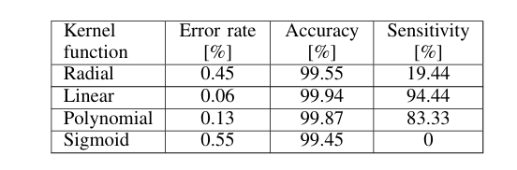
Performance
The classifier's performance was evaluated on the test set, and results from different SVM models were compared to assess classifier quality.​
The linear kernel model outperformed the others in predicting buying sessions, with a very low error rate and high sensitivity, making it suitable for predicting purchase likelihood.
Despite high accuracy, the radial and sigmoid kernels were ineffective in predicting buying sessions, which is crucial in the e-commerce context.

Slide 79
Performance
The classifier's performance was evaluated on the test set, and results from different SVM models were compared to assess classifier quality.​
The linear kernel model outperformed the others in predicting buying sessions, with a very low error rate and high sensitivity, making it suitable for predicting purchase likelihood.
Despite high accuracy, the radial and sigmoid kernels were ineffective in predicting buying sessions, which is crucial in the e-commerce context.

Slide 80

Performance
High Accuracy
Low Error rate
All models showed high accuracy, ranging from 99.45% to 99.94%.
The error rates were low, ranging from 0.06% to 0.55%.
The classifier's performance was evaluated on the test set, and results from different SVM models were compared to assess classifier quality.​
The linear kernel model outperformed the others in predicting buying sessions, with a very low error rate and high sensitivity, making it suitable for predicting purchase likelihood.
Despite high accuracy, the radial and sigmoid kernels were ineffective in predicting buying sessions, which is crucial in the e-commerce context.
This analysis demonstrates that, although accuracy is high across all models, the linear kernel provided the best performance for predicting buying sessions, which is key for online retailers.

Slide 81
Performance
High Accuracy
Low Error rate
All models showed high accuracy, ranging from 99.45% to 99.94%.
The error rates were low, ranging from 0.06% to 0.55%.
The classifier's performance was evaluated on the test set, and results from different SVM models were compared to assess classifier quality.​
The linear kernel model outperformed the others in predicting buying sessions, with a very low error rate and high sensitivity, making it suitable for predicting purchase likelihood.
Despite high accuracy, the radial and sigmoid kernels were ineffective in predicting buying sessions, which is crucial in the e-commerce context.
This analysis demonstrates that, although accuracy is high across all models, the linear kernel provided the best performance for predicting buying sessions, which is key for online retailers.

Slide 82
Reflections
The study highlighted the importance of kernel selection in SVM models, with the linear kernel proving most effective in this context.
The classifier could be applied in real-time on e-commerce sites to predict buying behavior and personalize user experience by prioritizing likely buyers during peak traffic.
Using low-level HTTP data instead of transactional data allows for a more generalized model applicable across different e-commerce platforms, but it may lack the precision of models using detailed user data.
Future work could involve testing the model in real-time applications and exploring other classifiers like decision trees and nearest neighbour for comparison.

Slide 83
Reflections
The study highlighted the importance of kernel selection in SVM models, with the linear kernel proving most effective in this context.
The classifier could be applied in real-time on e-commerce sites to predict buying behavior and personalize user experience by prioritizing likely buyers during peak traffic.
Using low-level HTTP data instead of transactional data allows for a more generalized model applicable across different e-commerce platforms, but it may lack the precision of models using detailed user data.
Future work could involve testing the model in real-time applications and exploring other classifiers like decision trees and nearest neighbour for comparison.

Slide 84
Reflections
The study highlighted the importance of kernel selection in SVM models, with the linear kernel proving most effective in this context.
The classifier could be applied in real-time on e-commerce sites to predict buying behavior and personalize user experience by prioritizing likely buyers during peak traffic.
Using low-level HTTP data instead of transactional data allows for a more generalized model applicable across different e-commerce platforms, but it may lack the precision of models using detailed user data.
Future work could involve testing the model in real-time applications and exploring other classifiers like decision trees and nearest neighbour for comparison.

Slide 85
Reflections
The study highlighted the importance of kernel selection in SVM models, with the linear kernel proving most effective in this context.
The classifier could be applied in real-time on e-commerce sites to predict buying behavior and personalize user experience by prioritizing likely buyers during peak traffic.
Using low-level HTTP data instead of transactional data allows for a more generalized model applicable across different e-commerce platforms, but it may lack the precision of models using detailed user data.
Future work could involve testing the model in real-time applications and exploring other classifiers like decision trees and nearest neighbour for comparison.

Slide 86
Reflections
The study highlighted the importance of kernel selection in SVM models, with the linear kernel proving most effective in this context.
The classifier could be applied in real-time on e-commerce sites to predict buying behavior and personalize user experience by prioritizing likely buyers during peak traffic.
Using low-level HTTP data instead of transactional data allows for a more generalized model applicable across different e-commerce platforms, but it may lack the precision of models using detailed user data.
Future work could involve testing the model in real-time applications and exploring other classifiers like decision trees and nearest neighbour for comparison.

Slide 87
Reflections
The study highlighted the importance of kernel selection in SVM models, with the linear kernel proving most effective in this context.
The classifier could be applied in real-time on e-commerce sites to predict buying behavior and personalize user experience by prioritizing likely buyers during peak traffic.
Using low-level HTTP data instead of transactional data allows for a more generalized model applicable across different e-commerce platforms, but it may lack the precision of models using detailed user data.
Future work could involve testing the model in real-time applications and exploring other classifiers like decision trees and nearest neighbour for comparison.

Slide 88
03
Gene Expression Data Classification using Support Vector Machine and Mutual Information-based Gene Selection.

Slide 89
03
Gene Expression Data Classification using Support Vector Machine and Mutual Information-based Gene Selection.

Slide 90
Problem: Classification of 2 cancer tissues
What is being analyzed: gene expressions of Microarray data
Case 1: Colon Cancer tissue cell
Total tissue samples: 62
Cancer tissue samples: 40
Normal tissue samples: 22
Total number of genes: 2000
Case 2: Colon Cancer tissue cell
Total tissue samples: 45
Activated B-like tissue samples: 22
Germinal Centre B-like tissue samples: 23
Total number of genes: 4026
Techniques used: SVM, Mutual Information, LOOCV
Notes:
Paper uses Microarray of samples to analyze the gene expressions

Slide 91
Problem: Classification of 2 cancer tissues
What is being analyzed: gene expressions of Microarray data
Case 1: Colon Cancer tissue cell
Total tissue samples: 62
Cancer tissue samples: 40
Normal tissue samples: 22
Total number of genes: 2000
Case 2: Colon Cancer tissue cell
Total tissue samples: 45
Activated B-like tissue samples: 22
Germinal Centre B-like tissue samples: 23
Total number of genes: 4026
Techniques used: SVM, Mutual Information, LOOCV
Notes:
Paper uses Microarray of samples to analyze the gene expressions

Slide 92
Problem: Classification of 2 cancer tissues
What is being analyzed: gene expressions of Microarray data
Case 1: Colon Cancer tissue cell
Total tissue samples: 62
Cancer tissue samples: 40
Normal tissue samples: 22
Total number of genes: 2000
Case 2: Colon Cancer tissue cell
Total tissue samples: 45
Activated B-like tissue samples: 22
Germinal Centre B-like tissue samples: 23
Total number of genes: 4026
Techniques used: SVM, Mutual Information, LOOCV
Notes:
Paper uses Microarray of samples to analyze the gene expressions

Slide 93
Problem: Classification of 2 cancer tissues
What is being analyzed: gene expressions of Microarray data
Case 1: Colon Cancer tissue cell
Total tissue samples: 62
Cancer tissue samples: 40
Normal tissue samples: 22
Total number of genes: 2000
Case 2: Colon Cancer tissue cell
Total tissue samples: 45
Activated B-like tissue samples: 22
Germinal Centre B-like tissue samples: 23
Total number of genes: 4026
Techniques used: SVM, Mutual Information, LOOCV
Notes:
Paper uses Microarray of samples to analyze the gene expressions

Slide 94
Problem
A common issue with analyzation of gene expression is high dimensionality. This means that there is a low amount of data samples but a disproportionate high number of features. This could lead to overfitting if not taken into consideration if it is used as input features for the classifier.
A small dataset also means that a classification model has to adapt to a low number of samples. This is the reason why SVM is used for low amounts of data samples due its mentioned features and characteristics.
A second underlying issues is the assessment of the performance of the classifier. A performance measure is needed to ensure the classifier is performing correctly. Thus, an ability tester would be needed for classifying the datasets.

Slide 95
Problem
A common issue with analyzation of gene expression is high dimensionality. This means that there is a low amount of data samples but a disproportionate high number of features. This could lead to overfitting if not taken into consideration if it is used as input features for the classifier.
A small dataset also means that a classification model has to adapt to a low number of samples. This is the reason why SVM is used for low amounts of data samples due its mentioned features and characteristics.
A second underlying issues is the assessment of the performance of the classifier. A performance measure is needed to ensure the classifier is performing correctly. Thus, an ability tester would be needed for classifying the datasets.

Slide 96
Solution
Problem | Proposed solution
High-dimensionality | Mutual information
Testing classifier performance | Leave-one-out-cross-validation method (LOOCV)
Small dataset | Support Vector Machine
Mutual information: Selects genes with the most relevant features for the prediction and only selects those as the input features.
LOOCV: Tests the ability of the classifier by putting all samples into a subset (K) before K-1, leaving out one sample out of the subset. The subset is then trained before using testing on the left out sample.
Support vector Machine: Utilized for its characteristic of using any dataset regardless of size to its full use.

Slide 97
Solution
Problem | Proposed solution
High-dimensionality | Mutual information
Testing classifier performance | Leave-one-out-cross-validation method (LOOCV)
Small dataset | Support Vector Machine
Mutual information: Selects genes with the most relevant features for the prediction and only selects those as the input features.
LOOCV: Tests the ability of the classifier by putting all samples into a subset (K) before K-1, leaving out one sample out of the subset. The subset is then trained before using testing on the left out sample.
Support vector Machine: Utilized for its characteristic of using any dataset regardless of size to its full use.

Slide 98
Solution
Problem | Proposed solution
High-dimensionality | Mutual information
Testing classifier performance | Leave-one-out-cross-validation method (LOOCV)
Small dataset | Support Vector Machine
Mutual information: Selects genes with the most relevant features for the prediction and only selects those as the input features.
LOOCV: Tests the ability of the classifier by putting all samples into a subset (K) before K-1, leaving out one sample out of the subset. The subset is then trained before using testing on the left out sample.
Support vector Machine: Utilized for its characteristic of using any dataset regardless of size to its full use.

Slide 99
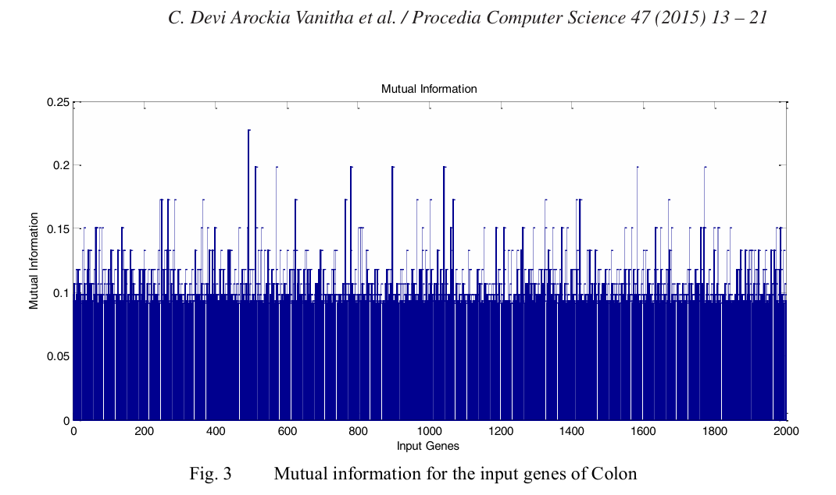
Mutual Information
The features from gene expression are selected based on relevant data of the predicted sample.
Mutual Information extracts the data and convert them into MI scores.
A higher MI score indicates a higher relevancy for the predicted sample.

Slide 100
Mutual Information
MI Score Results for case 1
Gene number | Gene ID | MI Score
493 | R87126 | 0.2276
1772 | H08393 | 0.1983
1582 | X63629 | 0.1983
1042 | R36977 | 0.1983
897 | H43887 | 0.1983
780 | H40095 | 0.1983
571 | R42501 | 0.1983
513 | M22382 | 0.1983
1671 | M26383 | 0.1729
1423 | J02854 | 0.1729
The features from gene expression are selected based on relevant data of the predicted sample.
Mutual Information extracts the data and convert them into MI scores.
A higher MI score indicates a higher relevancy for the predicted sample.

Slide 101
Mutual Information
MI Score Results for case 1
Gene number | Gene ID | MI Score
493 | R87126 | 0.2276
1772 | H08393 | 0.1983
1582 | X63629 | 0.1983
1042 | R36977 | 0.1983
897 | H43887 | 0.1983
780 | H40095 | 0.1983
571 | R42501 | 0.1983
513 | M22382 | 0.1983
1671 | M26383 | 0.1729
1423 | J02854 | 0.1729
The features from gene expression are selected based on relevant data of the predicted sample.
Mutual Information extracts the data and convert them into MI scores.
A higher MI score indicates a higher relevancy for the predicted sample.

Slide 102
Mutual Information
MI Score Results for case 1
Gene number | Gene ID | MI Score
493 | R87126 | 0.2276
1772 | H08393 | 0.1983
1582 | X63629 | 0.1983
1042 | R36977 | 0.1983
897 | H43887 | 0.1983
780 | H40095 | 0.1983
571 | R42501 | 0.1983
513 | M22382 | 0.1983
1671 | M26383 | 0.1729
1423 | J02854 | 0.1729
The features from gene expression are selected based on relevant data of the predicted sample.
Mutual Information extracts the data and convert them into MI scores.
A higher MI score indicates a higher relevancy for the predicted sample.

Slide 103
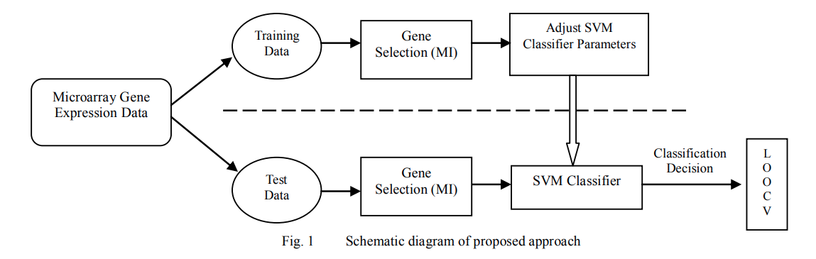
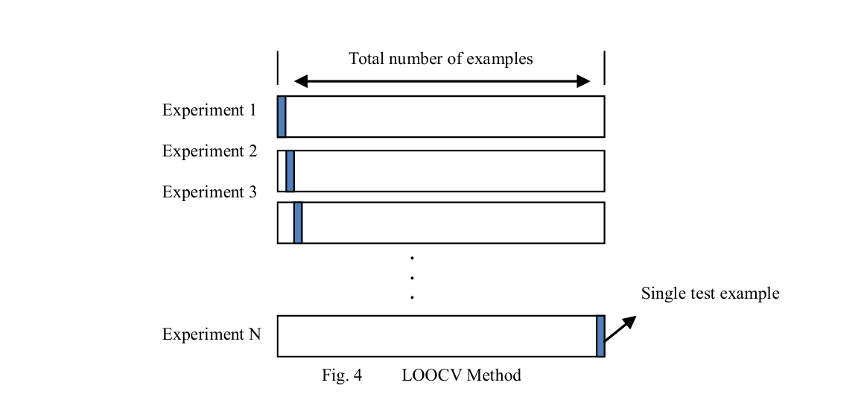
SVM Classifier with MI & LOOCV
Microarray Data Classification
Leave-One-Out-Cross-Validation

Slide 104
SVM Classifier with MI & LOOCV
Leave-One-Out-Cross-Validation
Microarray Data Classification

Slide 105
SVM Classifier with MI & LOOCV
Leave-One-Out-Cross-Validation
Microarray Data Classification

Slide 106
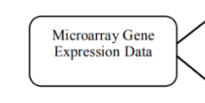
Represents the complete dataset of profiles

Slide 107
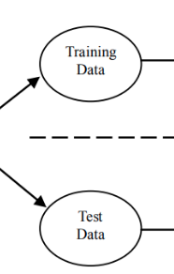
Training Data: Used to train the SVM Classifier.
Represents the complete dataset of profiles
The data gets split into two distinct sets
Test Data: Used to evaluate the performance of the classifier.

Slide 108
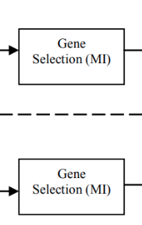
Training Data: Used to train the SVM Classifier.
Reduces dimensionality
Represents the complete dataset of profiles
The data gets split into two distinct sets
Mutual Information is applied to both datasets.
Helps focus on the most informative genes
Test Data: Used to evaluate the performance of the classifier.

Slide 109
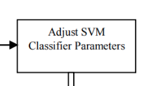
Training Data: Used to train the SVM Classifier.
Reduces dimensionality
Parameters are adjusted after initial gene selection to optimize the classifier.
i.e Kernel Type, Regularization Parameter
The data gets split into two distinct sets
Mutual Information is applied to both datasets.
Helps focus on the most informative genes
Test Data: Used to evaluate the performance of the classifier.

Slide 110
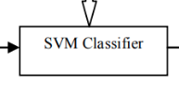
Reduces dimensionality
Parameters are adjusted after initial gene selection to optimize the classifier.
i.e Kernel Type, Regularization Parameter
Built using the training data with selected genes and learns the distinctions between predefined cancer tissue samples.
Mutual Information is applied to both datasets.
Helps focus on the most informative genes

Slide 111


Parameters are adjusted after initial gene selection to optimize the classifier.
i.e Kernel Type, Regularization Parameter
Built using the training data with selected genes and learns the distinctions between predefined cancer tissue samples.
Output from the SVM Classifier when applied to the test data.
Leave-One-Out Cross Validation is used to estimate the model’s performance.

Slide 112
Built using the training data with selected genes and learns the distinctions between predefined cancer tissue samples.
Output from the SVM Classifier when applied to the test data.
Leave-One-Out Cross Validation is used to estimate the model’s performance.

Slide 113
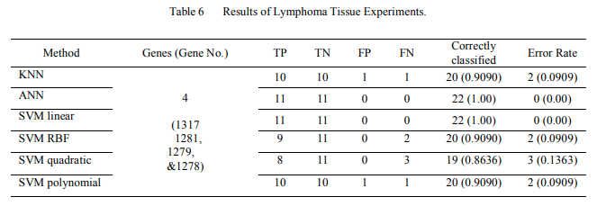
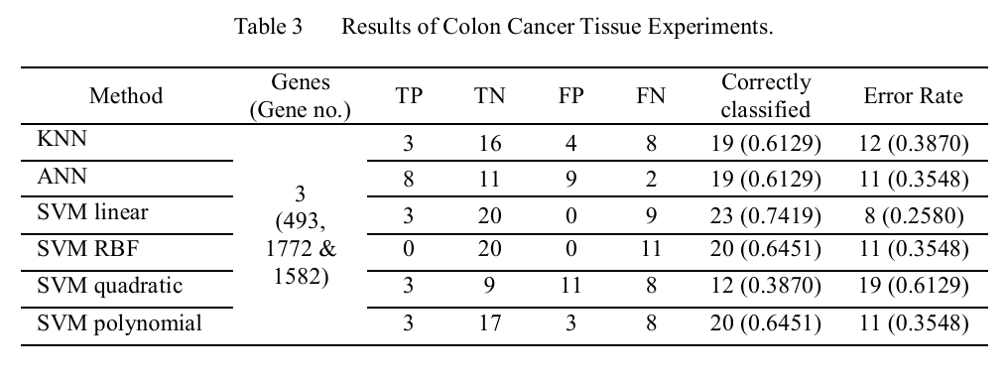
Results and Experiments : Case 1
Results and Experiments : Case 2
TP = Tumor tissues classified, TN = Normal Tissues classified,
FP = Normal tissues misclassified, FN = Tumor tissues misclassified

Slide 114
Results and Experiments : Case 1
Results and Experiments : Case 2
TP = Tumor tissues classified, TN = Normal Tissues classified,
FP = Normal tissues misclassified, FN = Tumor tissues misclassified

Slide 115
Results and Experiments : Case 1
Results and Experiments : Case 2
TP = Tumor tissues classified, TN = Normal Tissues classified,
FP = Normal tissues misclassified, FN = Tumor tissues misclassified

Slide 116
Results and Experiments : Case 1
Results and Experiments : Case 2
TP = Tumor tissues classified, TN = Normal Tissues classified,
FP = Normal tissues misclassified, FN = Tumor tissues misclassified

Slide 117
Reflection
For both cases, SVM Linear performed the best, with case 1 having an accuracy rate of 74% and case 2 with 100%. Judging from both cases, the classifier seemed be more appropriate when classifying between different cancer tissue samples. (case 2) than a binary classification of Normal and cancer tissue samples (case 1).
The worst performing classifier was SVM Quadratic, with the highest error rate within both cases. This may be because the sample size is quite small and Quadratic SVM emphasizes more on bigger datasets with more detailed features.
Perhaps using other ability classifier testers besides LOOVC may yield a more promising and diversed result as all cases' classification performance was assessed using LOOVC.
Notes:
-For both papers, SVM Linear performed the best, with case 1 having an accuracy rate of 74% and case 2 with 100%. Judging from both papers, the classifier seemed be more appropriate when classifying between different cancer tissue samples. (case 2) than a binary classification of Normal and cancer tissue samples (case 1).
-The worst performing classifier was SVM Quadratic, with the highest error rate within both cases. This may be because the sample size is quite small and Quadratic SVM emphasizes more on bigger datasets with more detailed features, as a smaller dataset could be overfitted whilst using a Quadratic SVM due to its complex technique of inputting its feature to a quadratic feature space.

Slide 118
Reflection
For both cases, SVM Linear performed the best, with case 1 having an accuracy rate of 74% and case 2 with 100%. Judging from both cases, the classifier seemed be more appropriate when classifying between different cancer tissue samples. (case 2) than a binary classification of Normal and cancer tissue samples (case 1).
The worst performing classifier was SVM Quadratic, with the highest error rate within both cases. This may be because the sample size is quite small and Quadratic SVM emphasizes more on bigger datasets with more detailed features.
Perhaps using other ability classifier testers besides LOOVC may yield a more promising and diversed result as all cases' classification performance was assessed using LOOVC.
Notes:
-For both papers, SVM Linear performed the best, with case 1 having an accuracy rate of 74% and case 2 with 100%. Judging from both papers, the classifier seemed be more appropriate when classifying between different cancer tissue samples. (case 2) than a binary classification of Normal and cancer tissue samples (case 1).
-The worst performing classifier was SVM Quadratic, with the highest error rate within both cases. This may be because the sample size is quite small and Quadratic SVM emphasizes more on bigger datasets with more detailed features, as a smaller dataset could be overfitted whilst using a Quadratic SVM due to its complex technique of inputting its feature to a quadratic feature space.

Slide 119
Reflection
For both cases, SVM Linear performed the best, with case 1 having an accuracy rate of 74% and case 2 with 100%. Judging from both cases, the classifier seemed be more appropriate when classifying between different cancer tissue samples. (case 2) than a binary classification of Normal and cancer tissue samples (case 1).
The worst performing classifier was SVM Quadratic, with the highest error rate within both cases. This may be because the sample size is quite small and Quadratic SVM emphasizes more on bigger datasets with more detailed features.
Perhaps using other ability classifier testers besides LOOVC may yield a more promising and diversed result as all cases' classification performance was assessed using LOOVC.
Notes:
-For both papers, SVM Linear performed the best, with case 1 having an accuracy rate of 74% and case 2 with 100%. Judging from both papers, the classifier seemed be more appropriate when classifying between different cancer tissue samples. (case 2) than a binary classification of Normal and cancer tissue samples (case 1).
-The worst performing classifier was SVM Quadratic, with the highest error rate within both cases. This may be because the sample size is quite small and Quadratic SVM emphasizes more on bigger datasets with more detailed features, as a smaller dataset could be overfitted whilst using a Quadratic SVM due to its complex technique of inputting its feature to a quadratic feature space.

Slide 120
Reflection
For both cases, SVM Linear performed the best, with case 1 having an accuracy rate of 74% and case 2 with 100%. Judging from both cases, the classifier seemed be more appropriate when classifying between different cancer tissue samples. (case 2) than a binary classification of Normal and cancer tissue samples (case 1).
The worst performing classifier was SVM Quadratic, with the highest error rate within both cases. This may be because the sample size is quite small and Quadratic SVM emphasizes more on bigger datasets with more detailed features.
Perhaps using other ability classifier testers besides LOOVC may yield a more promising and diversed result as all cases' classification performance was assessed using LOOVC.
Notes:
-For both papers, SVM Linear performed the best, with case 1 having an accuracy rate of 74% and case 2 with 100%. Judging from both papers, the classifier seemed be more appropriate when classifying between different cancer tissue samples. (case 2) than a binary classification of Normal and cancer tissue samples (case 1).
-The worst performing classifier was SVM Quadratic, with the highest error rate within both cases. This may be because the sample size is quite small and Quadratic SVM emphasizes more on bigger datasets with more detailed features, as a smaller dataset could be overfitted whilst using a Quadratic SVM due to its complex technique of inputting its feature to a quadratic feature space.

Slide 121
04
Conclusion

Slide 122
04
Conclusion

Slide 123
Why Support Vector Machines?
Paper 1
Paper 2
SVM is used to predict buying sessions in a web store based on low-level HTTP data from web server logs. The goal is to identify patterns in customer behaviour without relying on high-level transactional or customer demographic data. SVM's capability to handle complex, high-dimensional data makes it suitable for this task, as it can classify patterns that help predict purchase probability.
SVM is employed for gene expression data classification, where the challenge is to accurately classify data with many gene features and a small sample size. SVM is chosen for its flexibility in handling high-dimensional data, its ability to select relevant features, and its robustness against overfitting. The paper also integrates a Mutual Information (MI) technique for feature selection to identify informative genes, improving classification accuracy and training time.

Slide 124
Why Support Vector Machines?
Paper 1
Paper 2
SVM is used to predict buying sessions in a web store based on low-level HTTP data from web server logs. The goal is to identify patterns in customer behaviour without relying on high-level transactional or customer demographic data. SVM's capability to handle complex, high-dimensional data makes it suitable for this task, as it can classify patterns that help predict purchase probability.
SVM is employed for gene expression data classification, where the challenge is to accurately classify data with many gene features and a small sample size. SVM is chosen for its flexibility in handling high-dimensional data, its ability to select relevant features, and its robustness against overfitting. The paper also integrates a Mutual Information (MI) technique for feature selection to identify informative genes, improving classification accuracy and training time.

Slide 125
Comparison
Both studies applied Support Vector Machine (SVM) effectively in distinct fields—
e-commerce (customer classification) and bioinformatics (gene classification for disease).
The linear kernel outperformed others in both studies, offering high accuracy and sensitivity.
Performance & Practical Applications:
E-commerce: Linear SVM enables real-time user session management for personalized experiences.
Gene Classification: High accuracy with SVM supports its potential as a diagnostic tool, though further testing is needed.
In conclusion, SVM with linear kernel provides robust classification across diverse fields, highlighting its adaptability and reliability in data-driven prediction tasks.

Slide 126
Comparison
Both studies applied Support Vector Machine (SVM) effectively in distinct fields—
e-commerce (customer classification) and bioinformatics (gene classification for disease).
The linear kernel outperformed others in both studies, offering high accuracy and sensitivity.
Performance & Practical Applications:
E-commerce: Linear SVM enables real-time user session management for personalized experiences.
Gene Classification: High accuracy with SVM supports its potential as a diagnostic tool, though further testing is needed.
In conclusion, SVM with linear kernel provides robust classification across diverse fields, highlighting its adaptability and reliability in data-driven prediction tasks.

Slide 127
Comparison
Both studies applied Support Vector Machine (SVM) effectively in distinct fields—
e-commerce (customer classification) and bioinformatics (gene classification for disease).
The linear kernel outperformed others in both studies, offering high accuracy and sensitivity.
Performance & Practical Applications:
E-commerce: Linear SVM enables real-time user session management for personalized experiences.
Gene Classification: High accuracy with SVM supports its potential as a diagnostic tool, though further testing is needed.
In conclusion, SVM with linear kernel provides robust classification across diverse fields, highlighting its adaptability and reliability in data-driven prediction tasks.

Slide 128
Comparison
Both studies applied Support Vector Machine (SVM) effectively in distinct fields—
e-commerce (customer classification) and bioinformatics (gene classification for disease).
The linear kernel outperformed others in both studies, offering high accuracy and sensitivity.
Performance & Practical Applications:
E-commerce: Linear SVM enables real-time user session management for personalized experiences.
Gene Classification: High accuracy with SVM supports its potential as a diagnostic tool, though further testing is needed.
In conclusion, SVM with linear kernel provides robust classification across diverse fields, highlighting its adaptability and reliability in data-driven prediction tasks.

Slide 129
Comparison
Both studies applied Support Vector Machine (SVM) effectively in distinct fields—
e-commerce (customer classification) and bioinformatics (gene classification for disease).
The linear kernel outperformed others in both studies, offering high accuracy and sensitivity.
Performance & Practical Applications:
E-commerce: Linear SVM enables real-time user session management for personalized experiences.
Gene Classification: High accuracy with SVM supports its potential as a diagnostic tool, though further testing is needed.
In conclusion, SVM with linear kernel provides robust classification across diverse fields, highlighting its adaptability and reliability in data-driven prediction tasks.

Slide 130
Thank you for listening!
We would love to hear your questions

